Slide 1



GENBA SOPANRAO MOZE COLLEGE OF ENGINEERING
Balewadi,Pune 45
Department of Computer Engineering
Second Review
Plant Disease Identification
Batch Members: Guided by,
Sanjana Shinde (B39) Prof. Ashvini
Rani Pawar (B20) Bhosale, Priyanka Gosavi (A32) GSMCOE,
Aryan Pansare (B11) Pune

Slide 2

Introduction
The following project analyzes the data of trees and identifies the condition of them using CNN algorithm which is nothing but a deep learning algorithm along with the usage of other tools to identify the diseases and showcase the details, preventive measures, supplements for the plants of five datasets.

Slide 3
Literature Survey
Title of The paper | Description | Publication details
Plant Disease Detection and Classification by Deep Learning – A Review | It provides the research progress of deep learning technology in the field of crop leaf disease identification in recent years including current trends and challenges. | Lili Li, Shujuan Zhang, Bin Wang, et al. Vol. 9, 2169-3536, 2021
Using deep learning for image-based plant disease detection | This research focuses on public dataset of many images of diseased and healthy plant leaves collected under controlled conditions where the trained model achieves an accuracy of 99.35% on a held-out test set, demonstrating the feasibility of this approach. | S. P. Mohanty, D. P. Hughes, and M. Salathé, Vol. 7, 2016

Slide 4
Literature Survey
Title of The paper | Description | Publication details
A Systematic Literature Review on Plant Disease Detection: Motivations, Classification Techniques, Datasets, Challenges, and Future Trends | Their study is based on the importance of comprehensive screening process which contains test results of several crops, including grapes, rice, apples, cucumbers, maize, tomatoes, wheat, and potatoes mainly on the hyperspectral imagery and vision-centered approaches. | Wasswa Shafik, Ali Tufail, Abdallah Nomoun, et al, Vol. 9, 2169-3536, 2023
Deep inside convolutional networks: visualising image classification models and saliency maps | This paper addresses the visualisation of image classification models, learnt using CNN which are based on computing the gradient of the class score with respect to the input image. | Simonyan K, Vedaldi A, Zisserman A, 2013

Slide 5
Aim & Objective
Plant Disease Identification
To train the datasets and create a model for the same.
To implement web technologies in the frontend for the ‘Plant Disease Identification’ portal.
Including other datasets along with previous ones.
Showcasing predicted image, safety measures and exact or alternative fertilizer/supplement w.r.t the condition of the plant.

Slide 6
Proposed System
The proposed system not only supports five datasets but also supports images outside the datasets.
It uses many tools to produce effective and robust results which are enough to satisfy the needs.
It also predicts and forecasts the cure for the disease followed by its solution.
It has separate technologies used at the frontend and backend to provide better user experience.

Slide 7
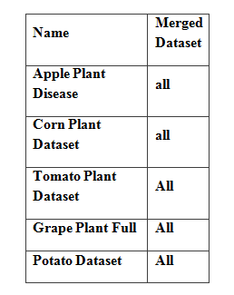
Methodology
Dataset
The following datasets will be used as samples of plants instead of actual plants -

Slide 8
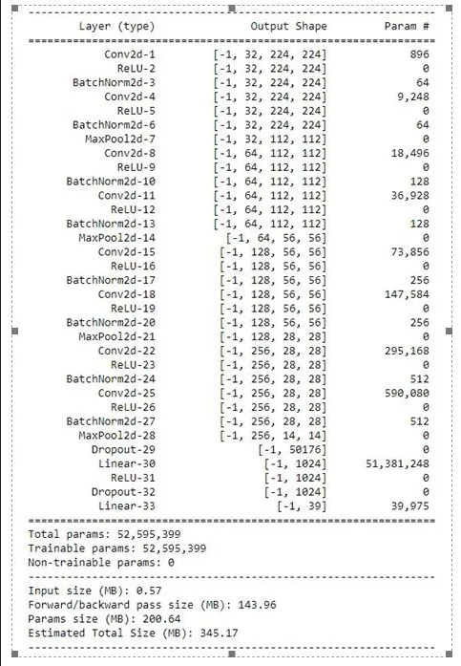
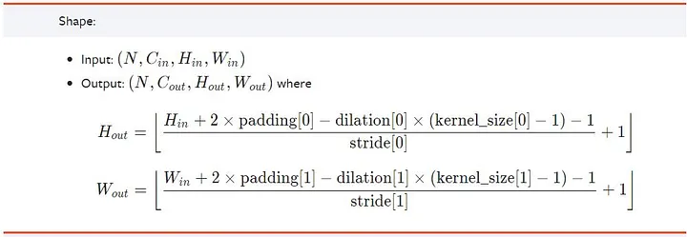
Methodology
Blueprint model of Raw Data

Slide 9
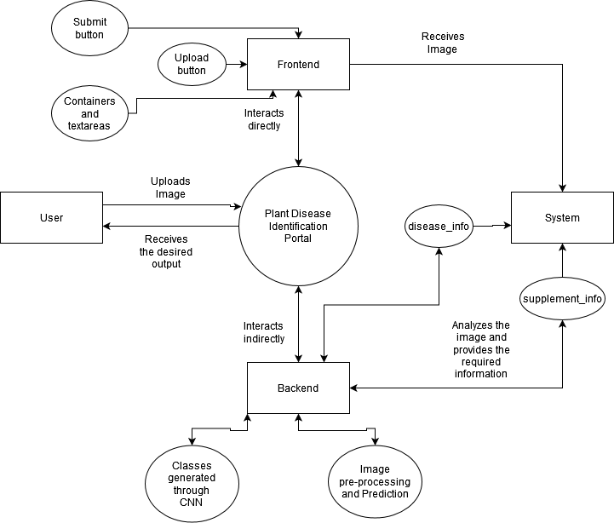
Methodology
DFD Level 2 diagram

Slide 10
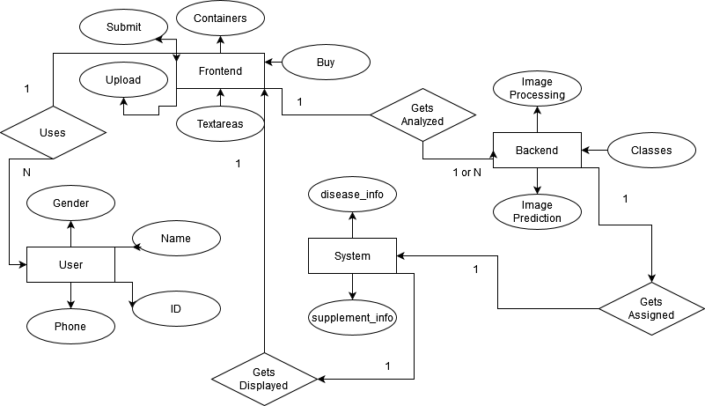
Methodology
Entity Relationship Diagram

Slide 11
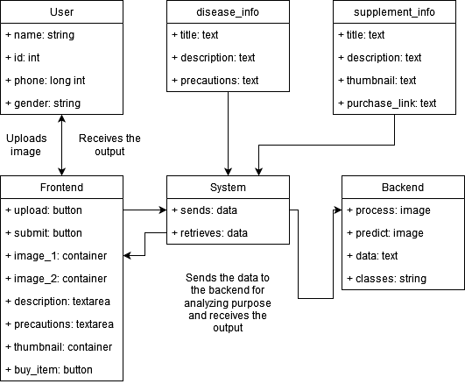
Methodology
UML Diagram

Slide 12
Methodology
Working
All these five datasets are merged into one folder which will be linked into the python program for training and model creation purpose.
As per the limit and restrictions of the current system, the datasets named ‘Tomato’, ‘Corn’ and ‘Potato’ have been used to test the program.

Slide 13
Methodology
The test images are taken as input from the user after which they are analyzed by converting the images into OpenCV format and making predictions for the same.
The condition of the plant is then identified and shown at last after performing the required calculations and final touches.

Slide 14
Methodology
Diseases
Scab
Black Rot
Cedar Rust
Powdery Mildew
Leaf Spot
Leaf Blight

Slide 15
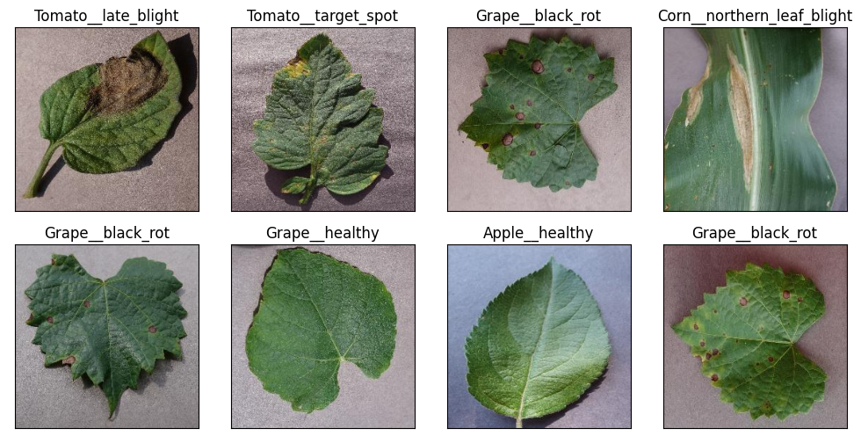
Methodology
Diseases

Slide 16
Methodology
Supplements
Katyayani Prozol Propiconazole
Magic Fungix
Omite Insecticide
Casa De Amor Organic Potash Fertilizer
CUREAL Fungicide and Bactericide
Antracol Fungicide

Slide 17
Algorithm/Techniques/Tools Used
The CNN algorithm is used to analyze the datasets which are in the form of images.
Python has been used in the frontend and at the backend.
The libraries or tools include like numpy, pandas, pillow, matplotlib, streamlit, opencv, tensorflow, keras.
Notepad, Command Prompt were used for testing and debugging purposes.

Slide 18
Project Plan
Gathering and downloading datasets onto local disk for offline purpose.
Merging all the mentioned datasets into one dataset.
Creating a python program to train the dataset and create the model.
Creating a python program which would make use of CNN algorithm to analyze the images.

Slide 19
Project Plan
Project Estimates
The time required to create the first part of the project along with 10 checkpoints.
The time taken by the second part to finish with 15 checkpoints.
The time taken to gather and verify the datasets.
The total estimation of the whole process including merging of datasets, creation of model and the classes.
The testing phases include trial and errors, modification of code, test cases.

Slide 20
Project Plan
Risk Management
Risk of mismatching the supplements with the diseased plants.
Risk of not showing the predicted image and instead replacing it with one from the internet.
Risk of not finding any cure or solution.
Risk of not providing any detailed proof or video with the preventive measures.

Slide 21
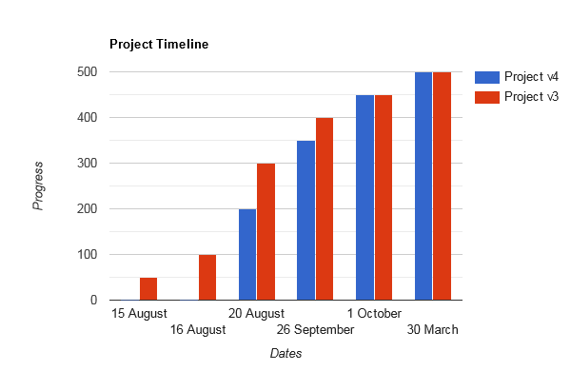
Project Plan
Project Timeline

Slide 22
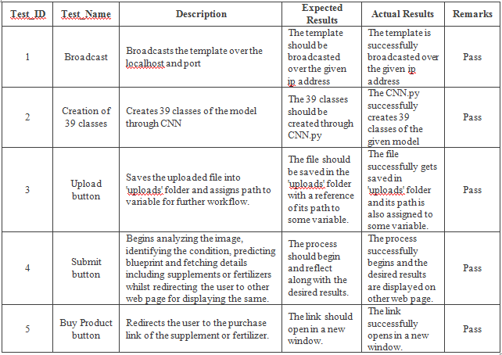
Project Plan
Test Case Results

Slide 23
References
Lili Li, Shujuan Zhang, Bin Wang, et al. “Plant Disease Detection and Classification by Deep Learning – A Review”, IEEE, vol. 9, doi: 10.1109/ACCESS.2021.3069646, 08.04.2021.
S. P. Mohanty, D. P. Hughes, and M. Salathé, “Using deep learning for image-based plant disease detection", Frontiers in plant science, vol. 7, doi: 10.3389/fpls.2016.01419, 22.09.2016.

Slide 24
References
Wasswa Shafik, Ali Tufail, Abdallah Nomoun, et al “A Systematic Literature Review on Plant Disease Detection: Motivations, Classification Techniques, Datasets, Challenges, and Future Trends”, IEEE, vol. 11, doi: 10.1109/ACCESS.2023.3284760, 09.06.2023.
Simonyan K, Vedaldi A, Zisserman A, “Deep inside convolutional networks: visualising image classification models and saliency maps”, arxiv preprint, arXiv:1312.6034, 2013.12.20.

Slide 25

THANK YOU

